Slide 1

Uber and Lyft Price Prediction
Lynne Chen, Dhruv Shah, Harsh Gandhi, Sahil Sahil, Mihir Koyande
Group -2
Theyab Alhwiti 12/06/2022

Slide 2
Introduction
The analysis conducted by our team compared 750,000 rideshares between Uber and Lyft in Boston, Massachusetts.
We collected our data from Kaggle and used this rich dataset to build a price prediction model.
We were inspired to pursue this challenge because of its relevance to us as college students, especially in Boston.

Slide 3
Problem Statement
The goal of this research is to create a fare prediction model for ride hailing companies Uber and Lyft in the Greater Boston area. We create multiple linear regression models for the two companies and compare the difference in their pricing strategies.
Uber and Lyft have made commuting reliable and convenient, especially for individuals who do not own personal vehicles. Regular consumers of these services often experience unusual price fluctuations for a given source and destination. Finding a model that accurately predicts fares can help consumers decide the best choice for the commute.

Slide 4
Methods
Data Preparation
Data Cleaning
Imputation
Results:
Modeling - Linear Regression , Random Forest
Data splitting
Variable Selection
Model Results and performance

Slide 5
Methods
Model Comparison
Model | Train R2 | Test R2 | Test RMSE | Accuracy
0 | Linear Regression | 0.936489 | 0.936337 | 2.532400 | 84.991037
1 | Random Forest | 0.980563 | 0.975919 | 1.557507 | 91.459743
 | Model | Train R2 | Test R2 | Test RMSE | Accuracy
0 | Linear Regression | 0.920045 | 0.918768 | 2.442493 | 88.128347
1 | Random Forest | 0.953556 | 0.947979 | 1.954609 | 91.794412

Slide 6
Results/Solutions
Uber is more economical; however, Lyft also provides fair competition.
People prefer to have shared rides during the nighttime.
People avoid taking rides when it rains.
When traveling long distances, the price does not increase linearly. However, based on the time and demand, a surge can affect the cost.
Uber can be the first choice for long distances.

Slide 7
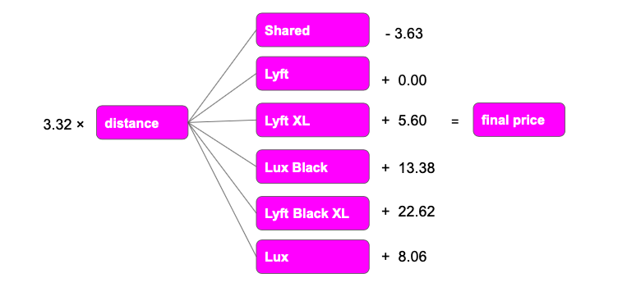
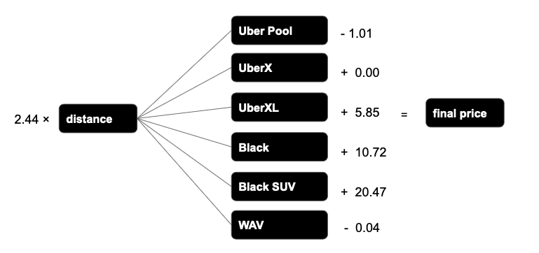
Results/Solutions
Conclusion:

Slide 8
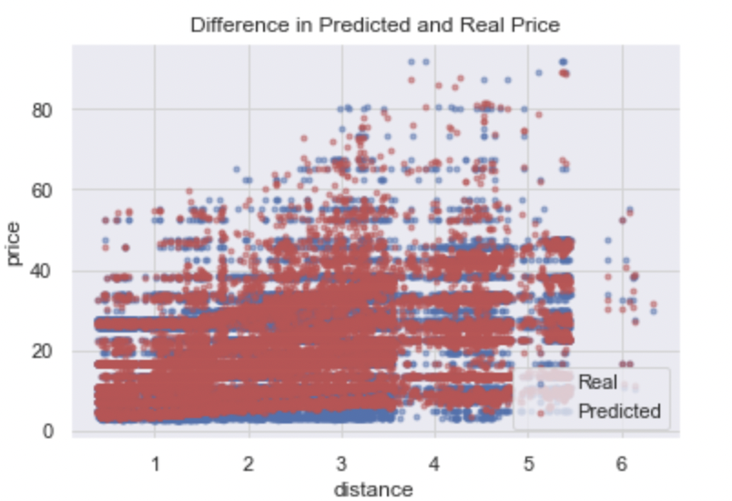
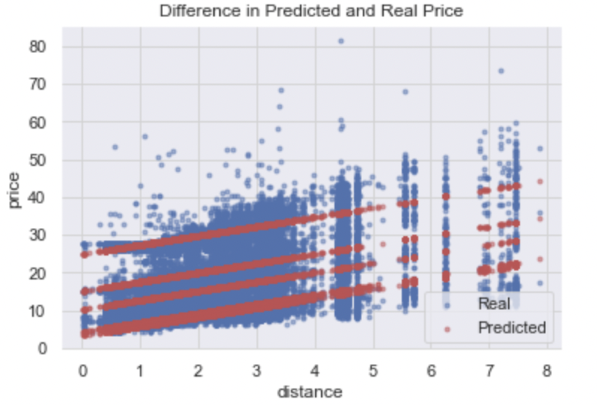
Results
The above tables show the different outputs obtained by running the two models for our prediction. Random Forest gave us the best predicting.
Linear Regression Plots: fig 1 lyft and fig 2 uber

Slide 9
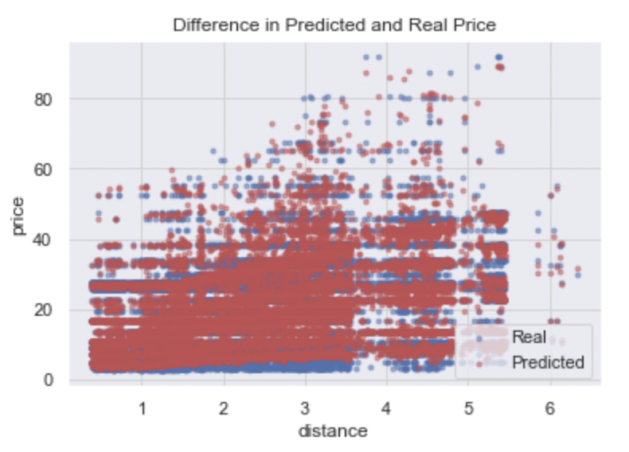
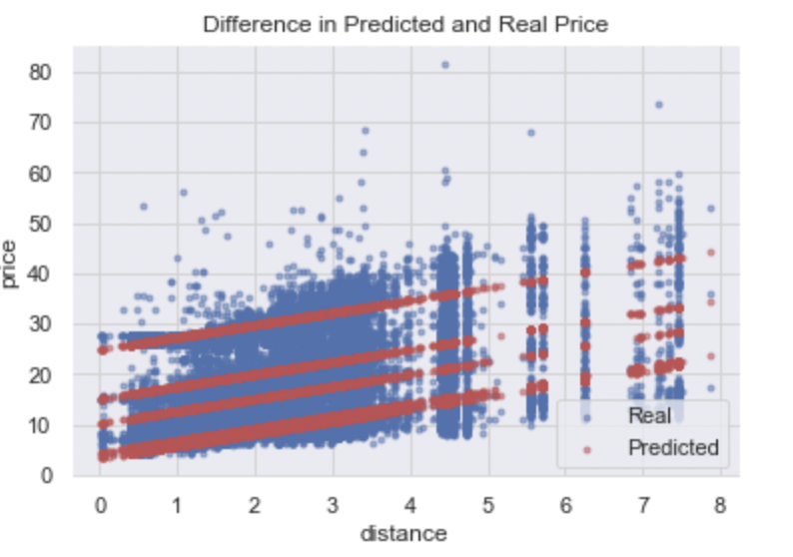
Results
Random Forest Plots: fig 1 lyft and fig 2 uber

Slide 10
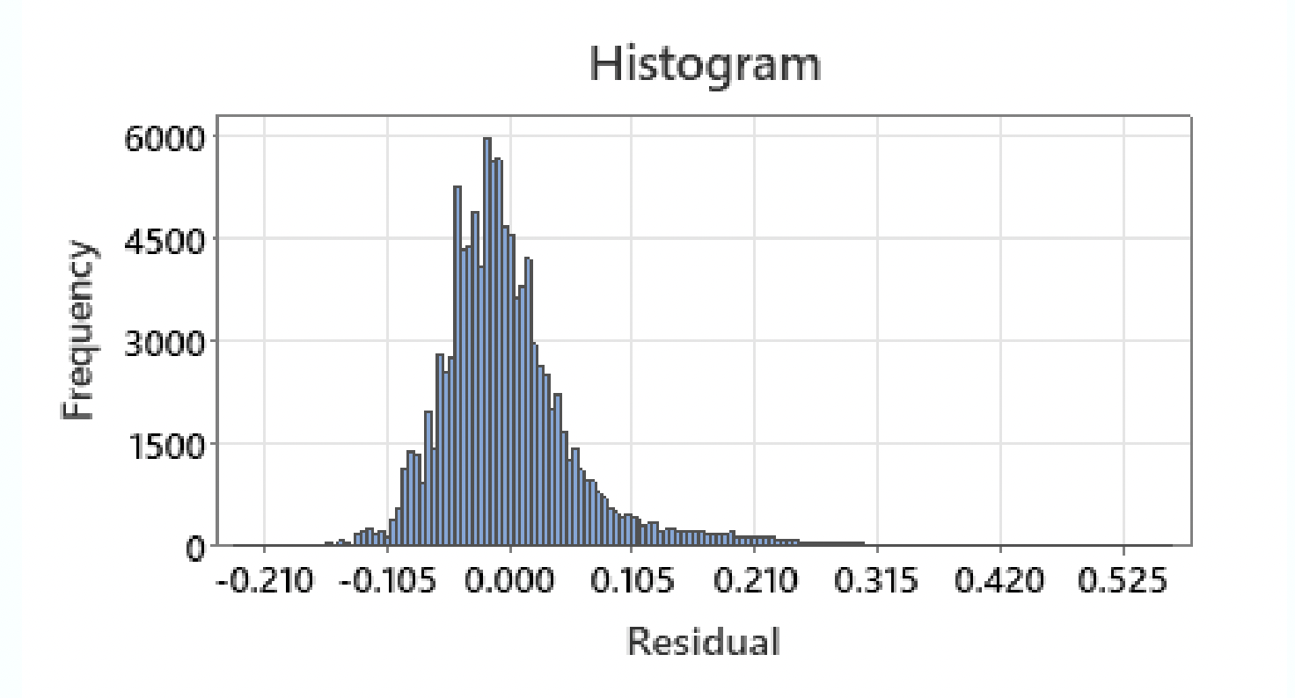
Limitation
One of the major limitations for our study was the data collection method. All data was collected during the month of November, in a particular part of Boston. Hence, the model might not accurately predict fares during other times of the year throughout the state. Furthermore, for the Uber dataset, conditions for inference were not met as we can see a strong skew to the right in the histogram of residuals. This indicates that residuals are not normally distributed.

Slide 11
Future Work
This project can be approached m ways and from different angles. The models can be improved to increase prediction precision. For instance, we could think about the interactions between the variables, such as the predictors for distance and cab types. With the ideal settings for the parameters, we can also investigate various Random Forests prediction error rates.
We intend to consider extraneous data to include traffic conditions and timeframes. We plan to get Uber and Lyft fare data from more areas in Boston and fit the data into out model. We also plan to study why we saw large standard deviation of fares for a given source and destination.

Slide 12
Conclusion
Random Forest performed the best in our case. We applied the basic Random Forest model without tuning any parameters. Even so, it turned out that the result executed by Random Forest was the best model
While Random Forest gave us the best predicting power, the Linear Model told us a better story. To better understand how price is calculated for Uber’s and Lyft’s’ ride, we derived coefficients from the linear Model.
We see that Lyft has a lower rate for distance than Uber, which implies that in general Lyft charges less for every additional mile, and long distance rides will be cheaper on Lyft compared to those on Uber. Also in Lyft, shared cab has a lower base price while high end products “Black” and “Black XL” have higher base prices.

